Slide 1
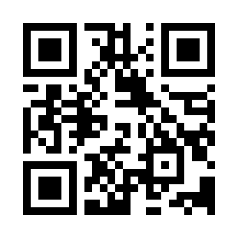


HTML Document Structure Quiz
https://bit.ly/3z4jBqf

